Slide 1
POWER

Slide 2
Power: T
Scenario: You are told that the average attendance to BYU basketball games for the season is 15,000 people a game. However, you know that BYU basketball has been playing terribly lately and you suspect that the average attendance is significantly lower.
H_{o}: μ = 15,000 vs. H_{a}: μ < 15,000
Approx. SD of attendance: 300
Smallest difference you want to detect (delta): 100
Alpha: .05
How many observations do you need in order to detect this difference with 80% power?

Slide 3
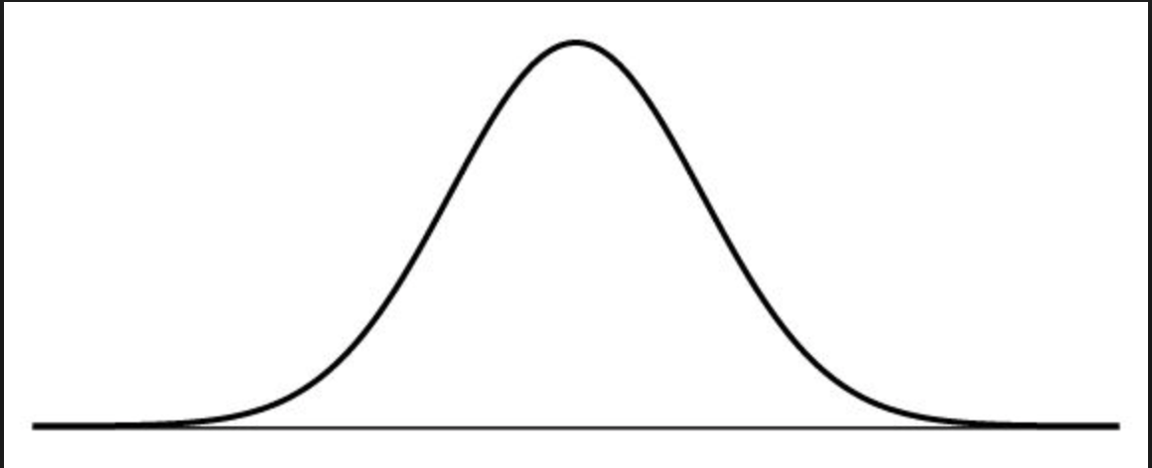





.05
.20
14,500
15,000

Slide 4
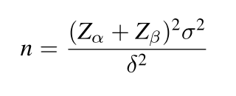
Formula

Slide 5
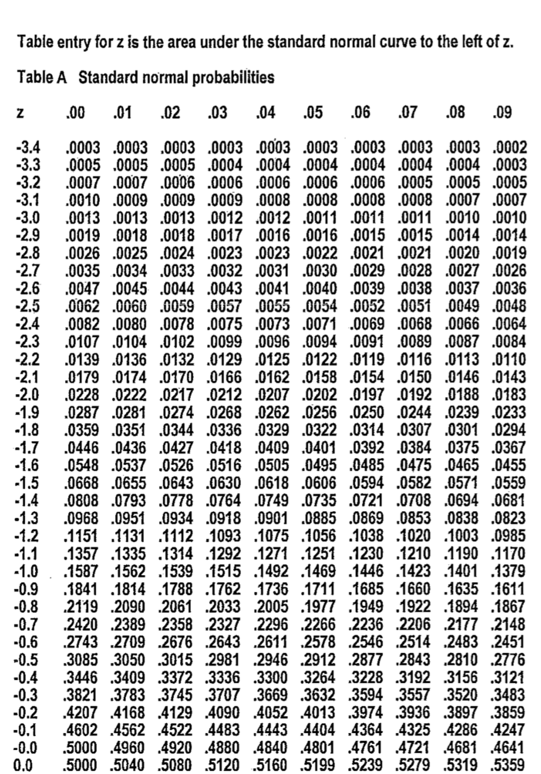
Z⍺ = -1.645

Slide 6
Z_{β} = -.845

Slide 7

Plug and chug
$$n= \frac{{\left(−1.645 − .845\right)}^{2}{(300)}^{2}}{{100}^{2}}=55.8009$$
So we need 56 observations in order to detect the difference

Slide 8
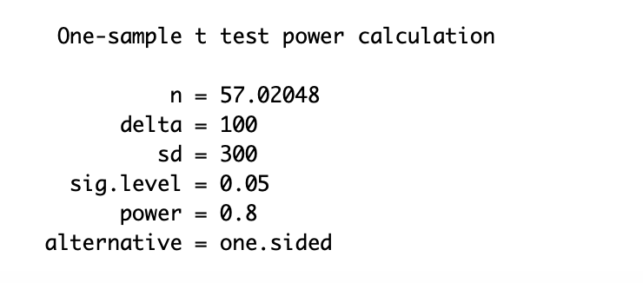
R code
power.t.test(delta = 100, sd = 300, sig.level = .05, power = .80,
type = "one.sample", alternative = "one.sided")
*Slightly off from our calculations by hand because R uses the exact Z⍺ and Z_{β} values

Slide 9
Power: ANOVA
Scenario: You are asked to determine the effect of class time on one’s final Stat 230 grade. There are 4 different class times, one at 9:00, 12:00, 1:00, and 4:00.
We suspect the average scores for the 12:00 and 1:00 classes to be the same and we hypothesize that the 9:00 scores will be 3 points higher than the 12:00 and 1:00 scores. We suspect that the 4:00 scores will be 3 points lower than the 12:00 and 1:00 scores.
How many observations do you need in order to detect this difference with 85% power?
Approx. SD of scores: 5
Significance level: .05

Slide 10
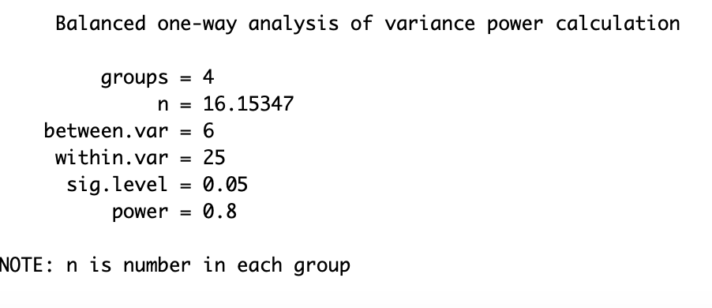
R code
power.anova.test(groups = 4, between.var = var(c(3,0,0,-3)), within.var = 5^2, sig.level = .05, power = .80)

Slide 11
Power: ANOVA
Scenario: You are asked to examine the effect of the type of car you drive on your auto insurance monthly payments. There are 5 classifications of cars: sedan, sports sedan, crossover, SUV, truck
We suspect the average payments for the SUV and truck to be the same. We suspect the payment for sedans to be $50 less and the payment for crossovers to be $25 less than the SUV/truck payment. We expect the sports sedan payments to be $30 higher than that of the SUV/truck.
How many observations do you need in order to detect this difference with 95% power?
Approx. SD of scores: $30
Significance level: .01

Slide 12
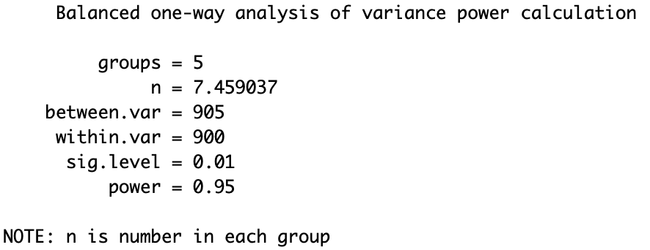
R-Code
power.anova.test(groups = 5, between.var = var(c(-50, -25,0,0,30)), within.var = 30^2, sig.level = .01, power = .95)

